Slide 1
GO HOME
Prepared By :
Krisha Desai(196150316008)
Hetvi Modi(196150316034)
INFORMATION TECHNOLOGY
GOVERNMENT POLYTECHINC FOR GIRLS, SURAT

Slide 2
Abstract
This work demonstrates a simple home automation system that allows the user to control home appliances through Wi-Fi/Bluetooth. Lights, air conditioners and fans are the appliances that can be used in this system. In this system, the controlling and monitoring the appliances can perform by using smartphone based on Android Application. The concept behind this can be to manage home devices with voice. On the market, there are several devices accessible to try and do that. Build your personal assistant which will do the work for you. The idea behind this can be to control home devices with voice. On the market, there is a unit several devices out there to try and do that. However, creating your own is awful. Build your personal assistant that may do the work for you. Simply your assistant needs voice commands. Consistent with voice command home appliances can switch ON/OFF.

Slide 3
Problem Statement
The field of automation has well advanced in Industries, as majority of automobile industry plants as well as bottling plants have automated assembly lines. But automation has not yet penetrated in the homes especially in India.
It is difficult for senior citizen and handicapped people to get up for turning on/off appliances.
In market there are many devices related to Home Automation, for instance, Alexa & Google Home which is expensive , So, not everyone can afford it.

Slide 4
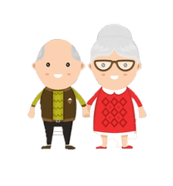

Who has this Problem?
Senior Citizens
Handicapped

Slide 5
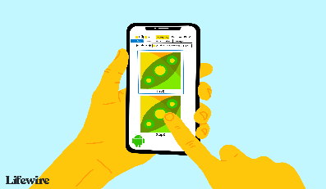
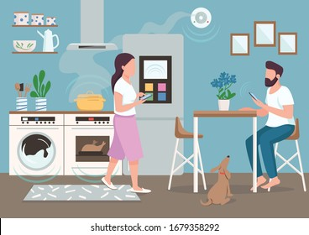
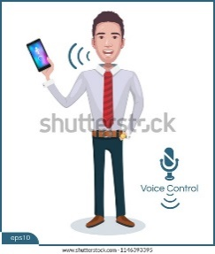
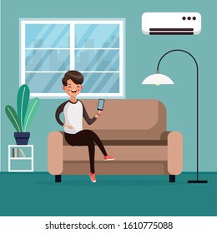

How does it work?

Slide 6
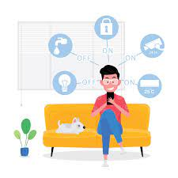
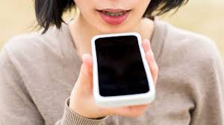
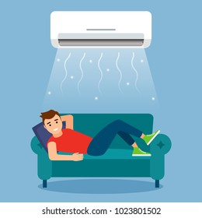
Features
On/Off Appliances
Voice Over
AC/Fan Control

Slide 7
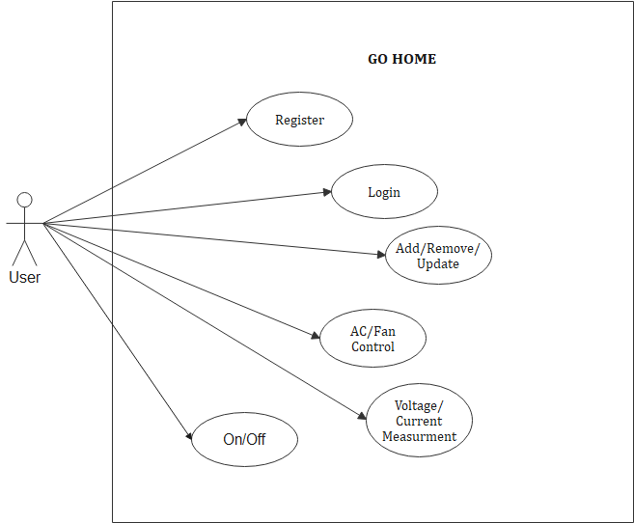
Use Case Diagram

Slide 8
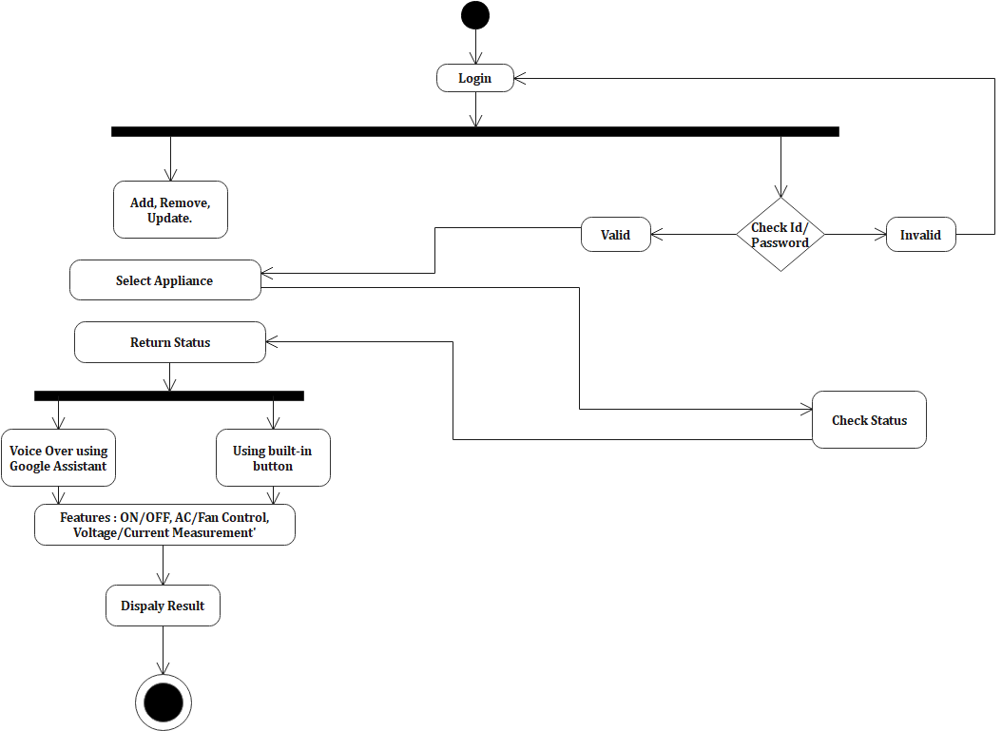
Activity Diagram

Slide 9



How our proposed solution is different from existing solution available in market?
There are lots of application available in market related to this but this application provides some special and extra functionality which are this : -
Can Connect to every company Appliance
Voice Over
Low Cost

Slide 10



Competitor Analysis
Name of competitor
Smart Things
Mi Remote Control
Philips Hue

Slide 11
Conclusion
The system as the name indicates, ‘Home automation’ makes the system more flexible and provides attractive user interface compared to other home automation systems. In this system we integrate mobile devices into home automation systems. A novel architecture for a home automation system is proposed using the relatively new communication technologies. We hide the complexity of the notions involved in the home automation system by including them into a simple, but comprehensive set of related concepts. This simplification is needed to fit as much of the functionality on the limited space offered by a mobile device’s display.Finally, the proposed system is better from the scalability and flexibility point of view than the commercially available home automation systems.

Slide 12
Thank You

